Slide 1


Slide 2
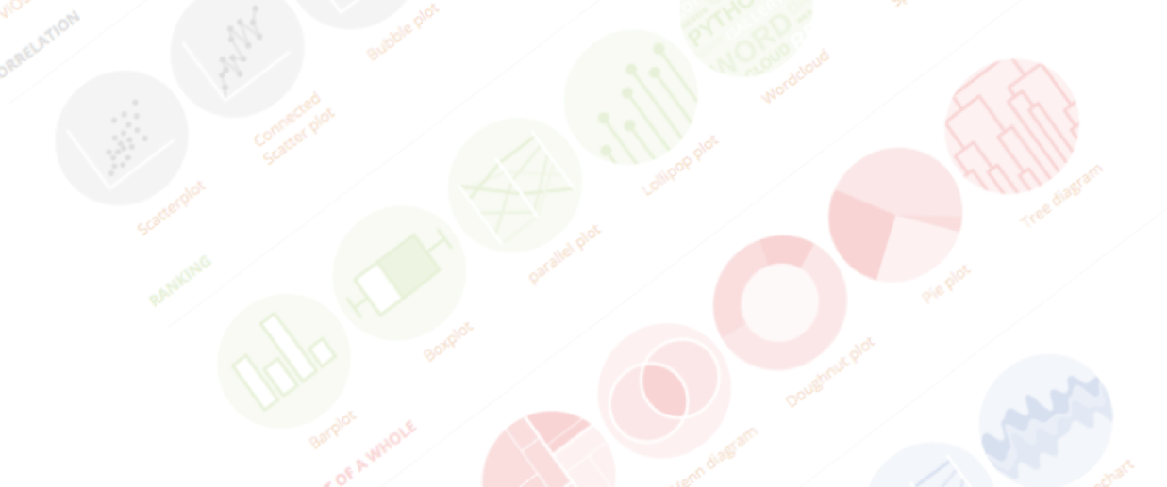

A project by Yan Holtz and Conor Healy
Choosing the right chart for your data
Belgium & Remote | September 2021

Slide 3

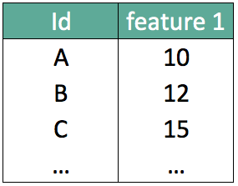
What should I do with my data ??

Slide 4
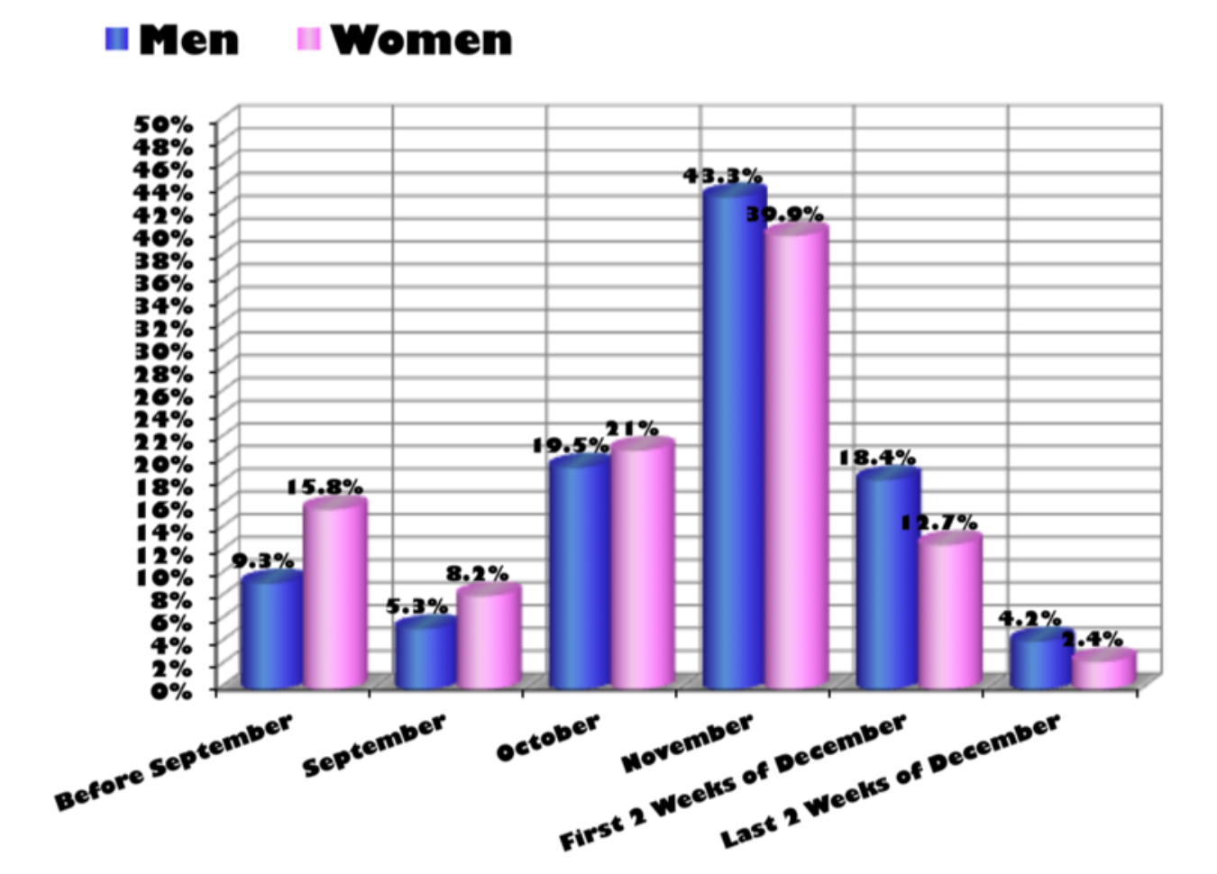
…
What about that?
Source: Storytelling with data by Cole Nussbaumer Knaflic

Slide 5

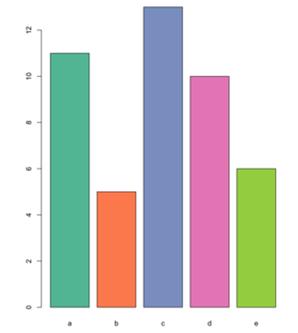

Design
Code

Slide 6
Design
Code

Slide 7
Looking for a chart ?
What you can do
What you should do
Caveats to avoid
How to
build it

Slide 8
WHAT YOU CAN DO
A classification of chart types based on data input format
www.data-to-viz.com/#explore

Slide 9

Scatterplot

Slide 10

Scatterplot
2d density chart

Slide 11
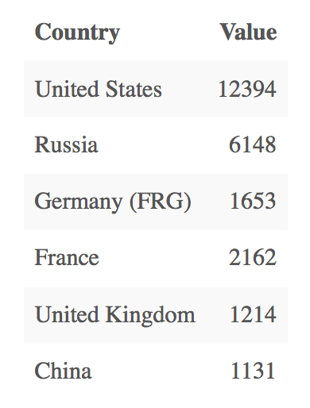
Who sells more weapons ?
?
Notes:
Very simple dataset,
-> What would you do ?
quantity of weapons exported by the top 50 largest exporters in 2017.
on the Stockholm International Peace Research Institute

Slide 12
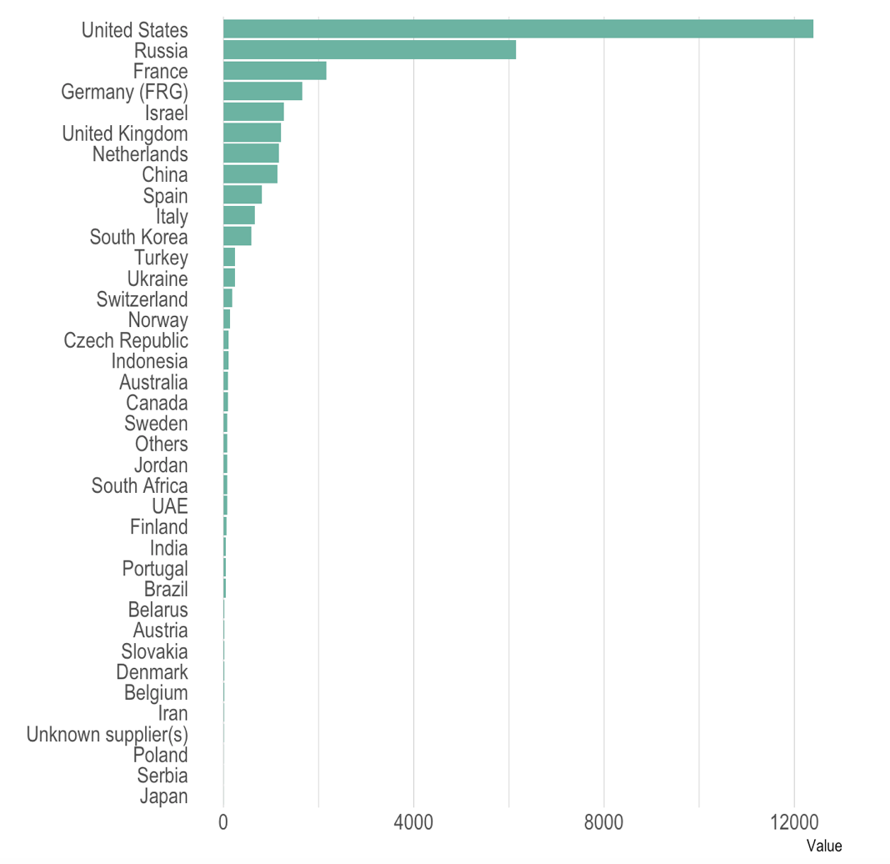
Who sells more weapons ?

Slide 13
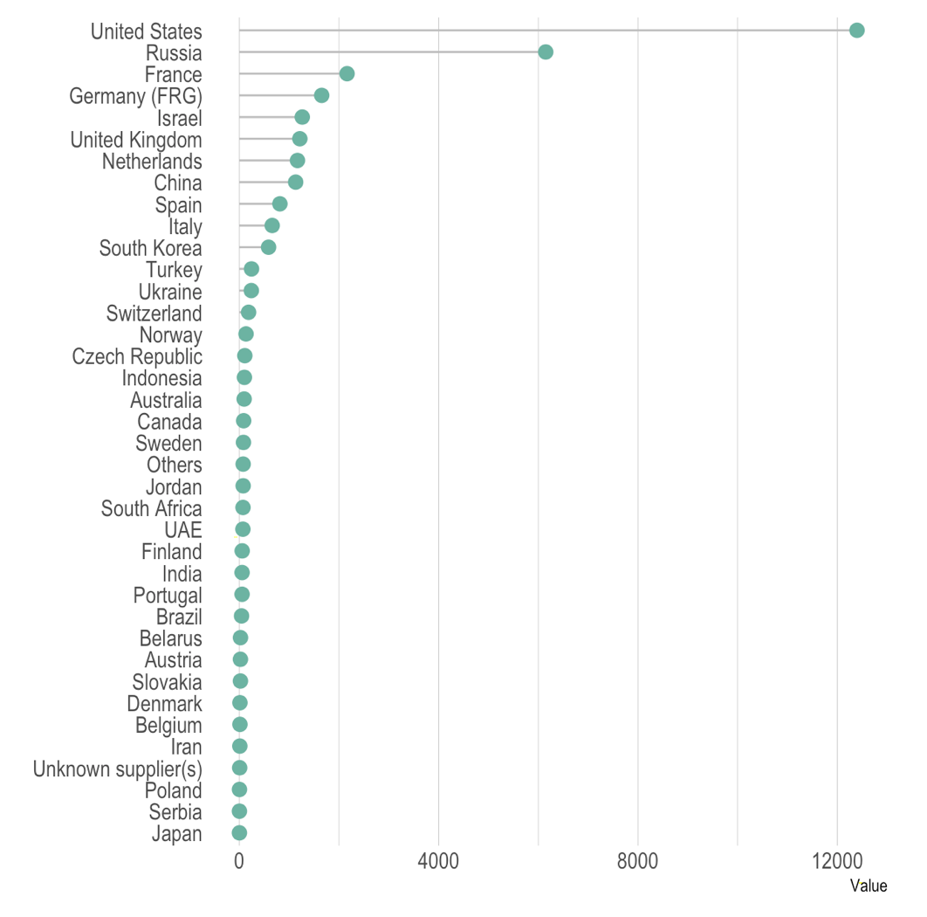
Who sells more weapons ?

Slide 14
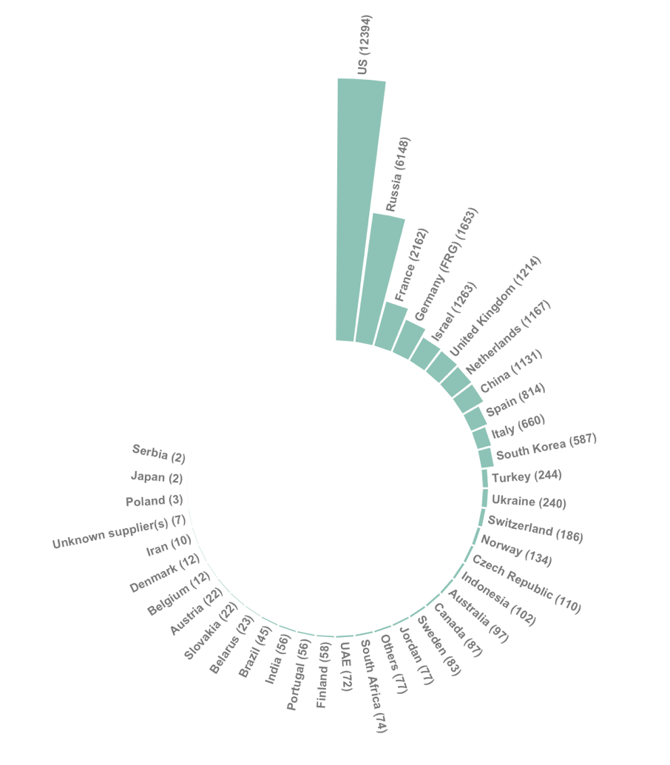
Who sells more weapons ?

Slide 15
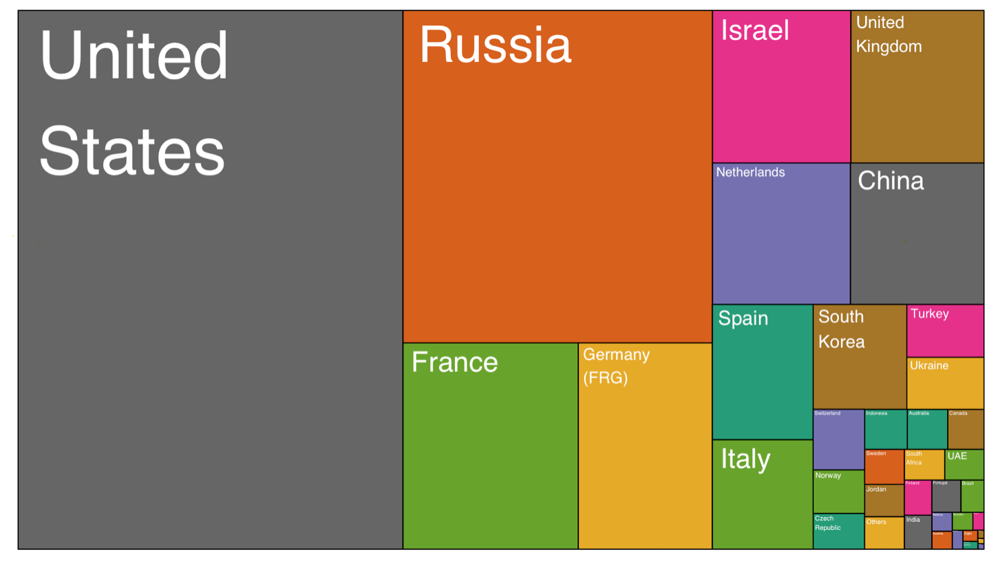
Who sells more weapons ?

Slide 16
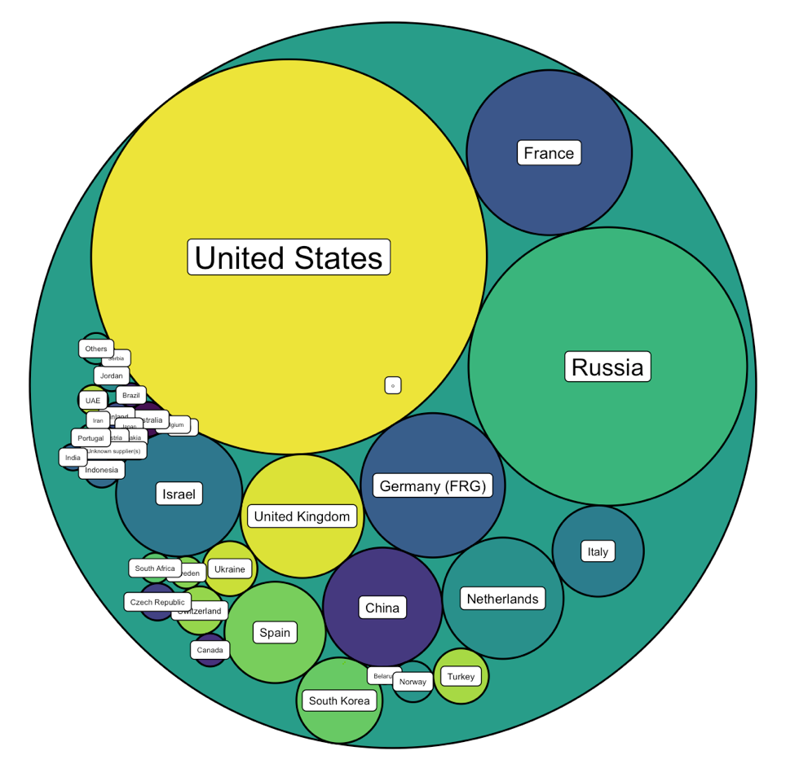
Who sells more weapons ?

Slide 17







Who sells more weapons ?

Slide 18
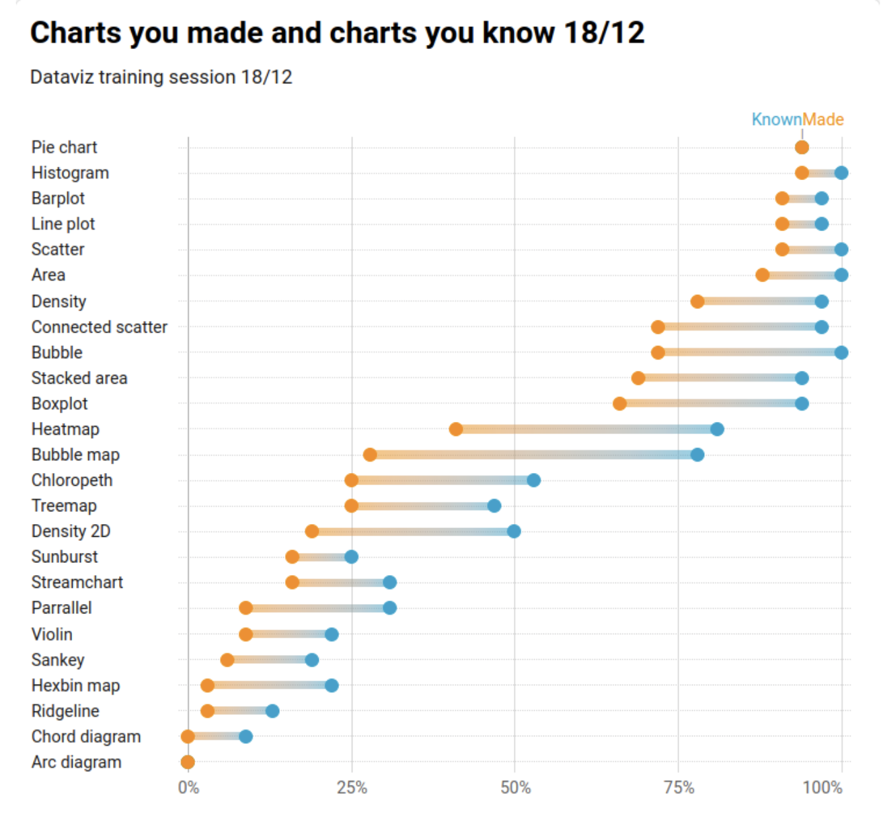

Slide 19
Who sells more weapons ?
1 observation per group
1 categorical variable
1 numerical variable

Slide 20
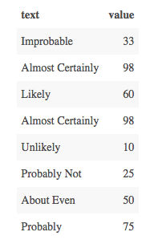
Perception of probability

Slide 21
Perception of probability
Several observations per group
1 categorical variable
1 numeric variable

Slide 22
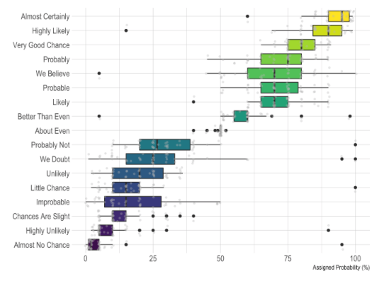
Perception of probability

Slide 23
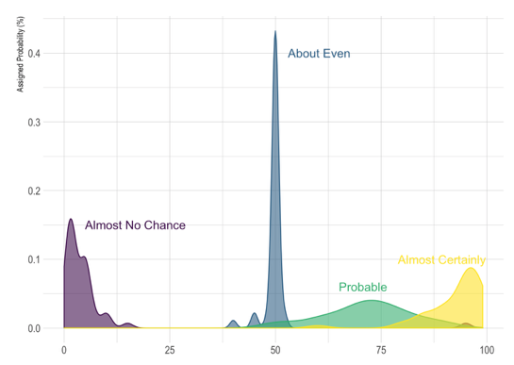
Perception of probability

Slide 24
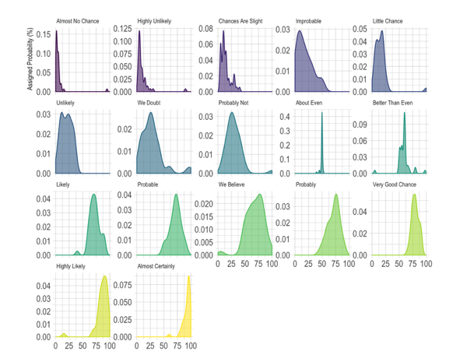
Perception of probability

Slide 25
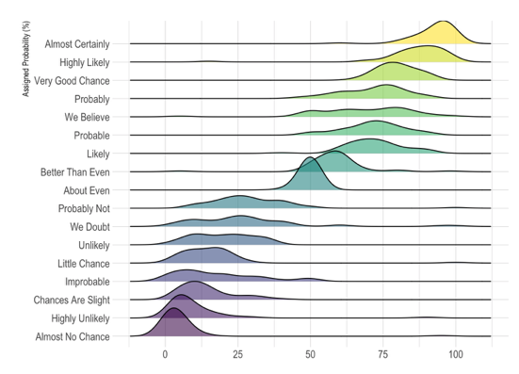
Perception of probability

Slide 26
So…
Knowing the possibilities is the first step in chart choice
Not easy to know all the chart types
Hard to figure out options from a dataset
Let’s build a decision tree
Notes:
Demo first part of the website

Slide 27
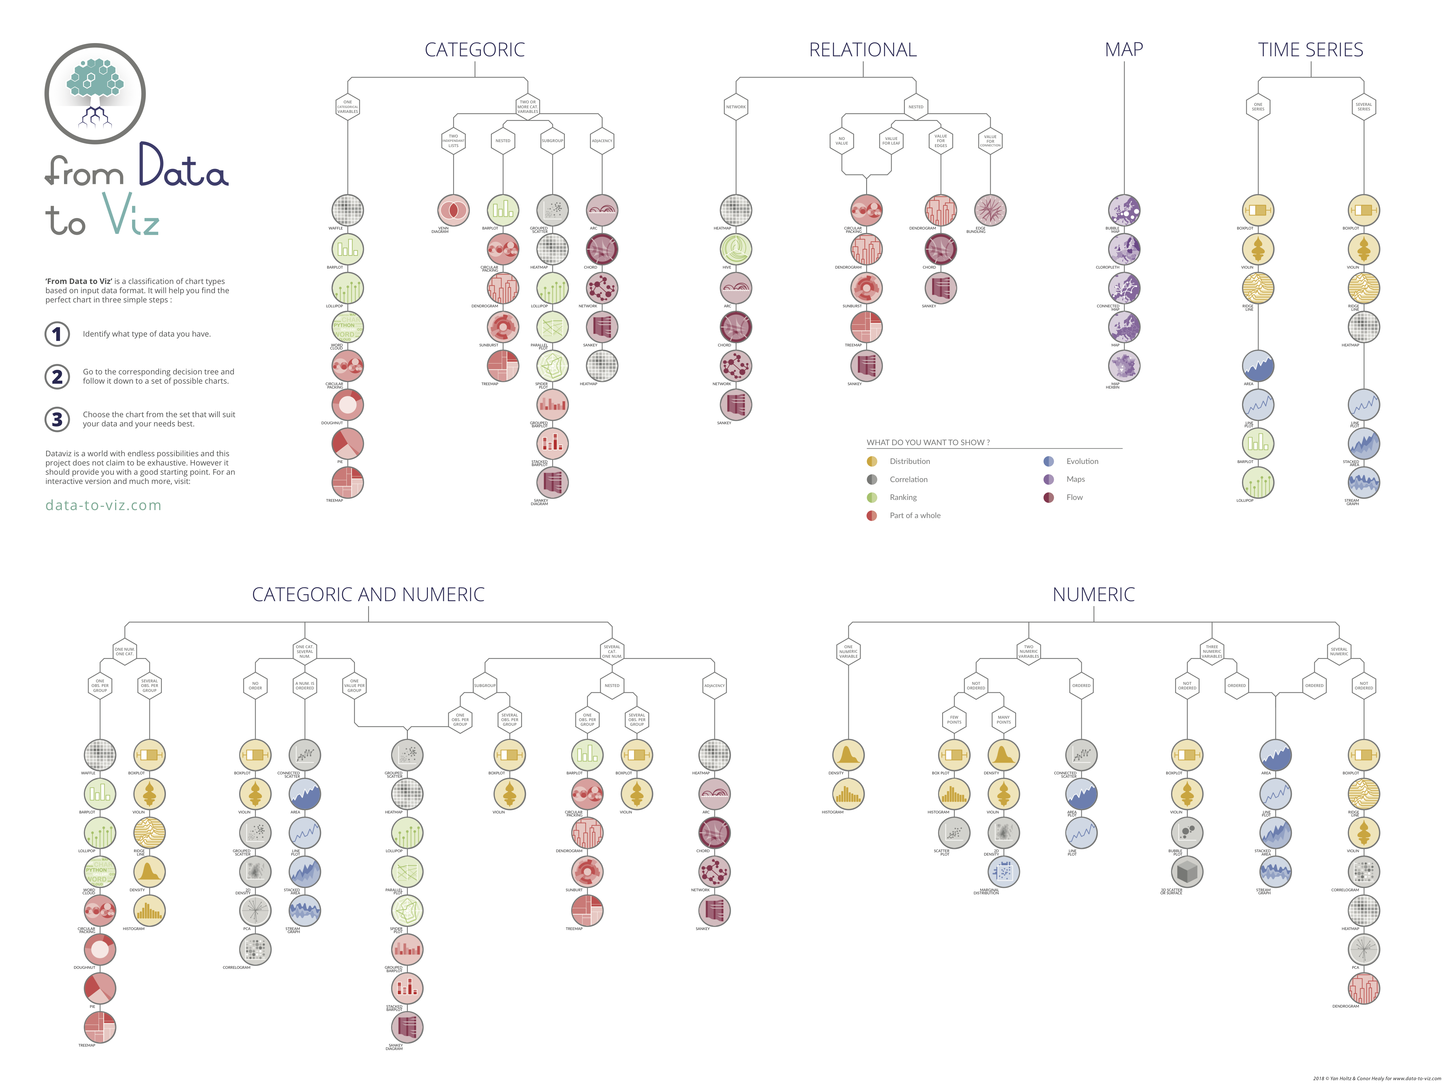
Notes:
+ WEBSITE DEMO

Slide 28
Data-to-viz.com
Notes:
Demo first part of the website

Slide 29
There are no limits in dataviz!
https://xeno.graphics/
Notes:
+ WEBSITE DEMO

Slide 30
WHAT YOU SHOULD DO
About 20 examples of storytelling with data
www.data-to-viz.com/#story

Slide 31
Eye catching / accurate
Question
Exploratory vs Explanatory
Chart Decision
Interactive or Static?
Who’s reading ?
Data itself

Slide 32
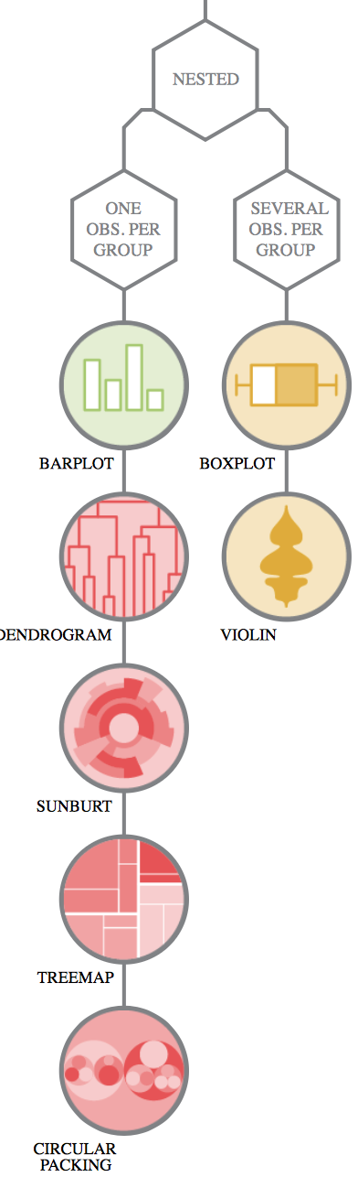
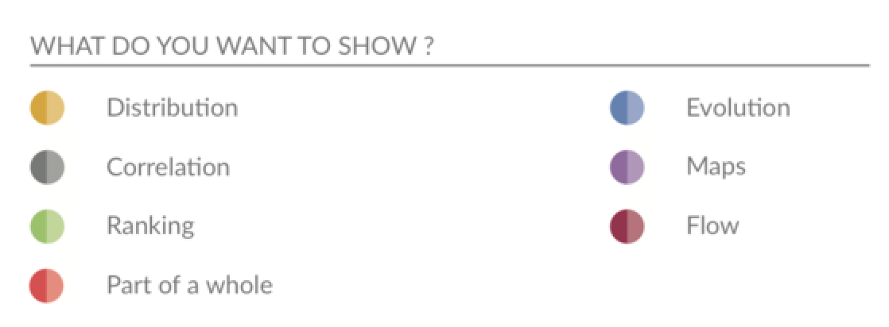
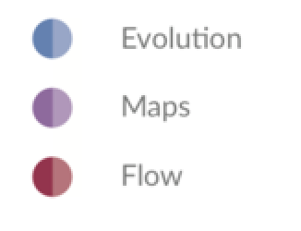
Question – Explo/Expla – Reader – Data – Interactivity – Eye catching
Notes:
Demo story part of the website Show that code is available

Slide 33
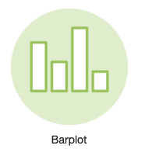
Who sells more weapons ?
South Korea > Spain ?
% of total sold by the US ?

Slide 34
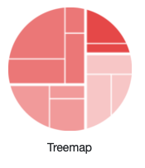
Who sells more weapons ?
South Korea > Spain ?
% of total sold by the US ?

Slide 35
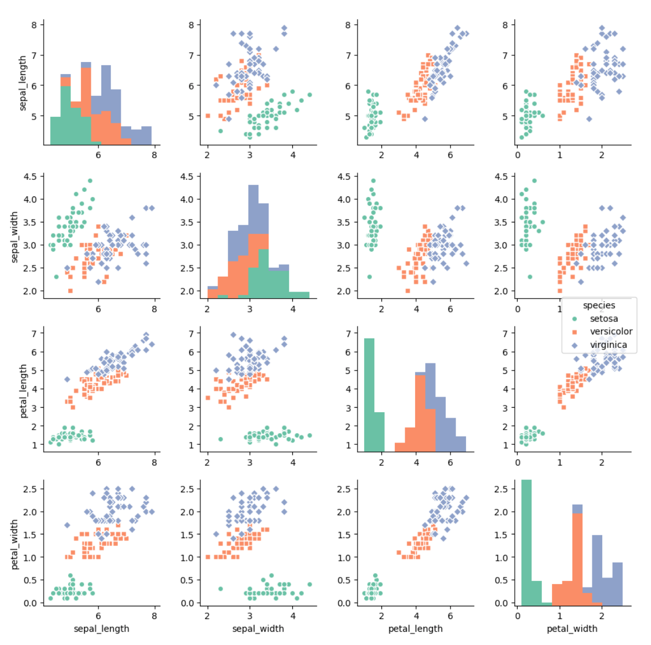
Question – Explo/Expla – Reader – Data – Interactivity – Eye catching
Notes:
Demo story part of the website Show that code is available

Slide 36
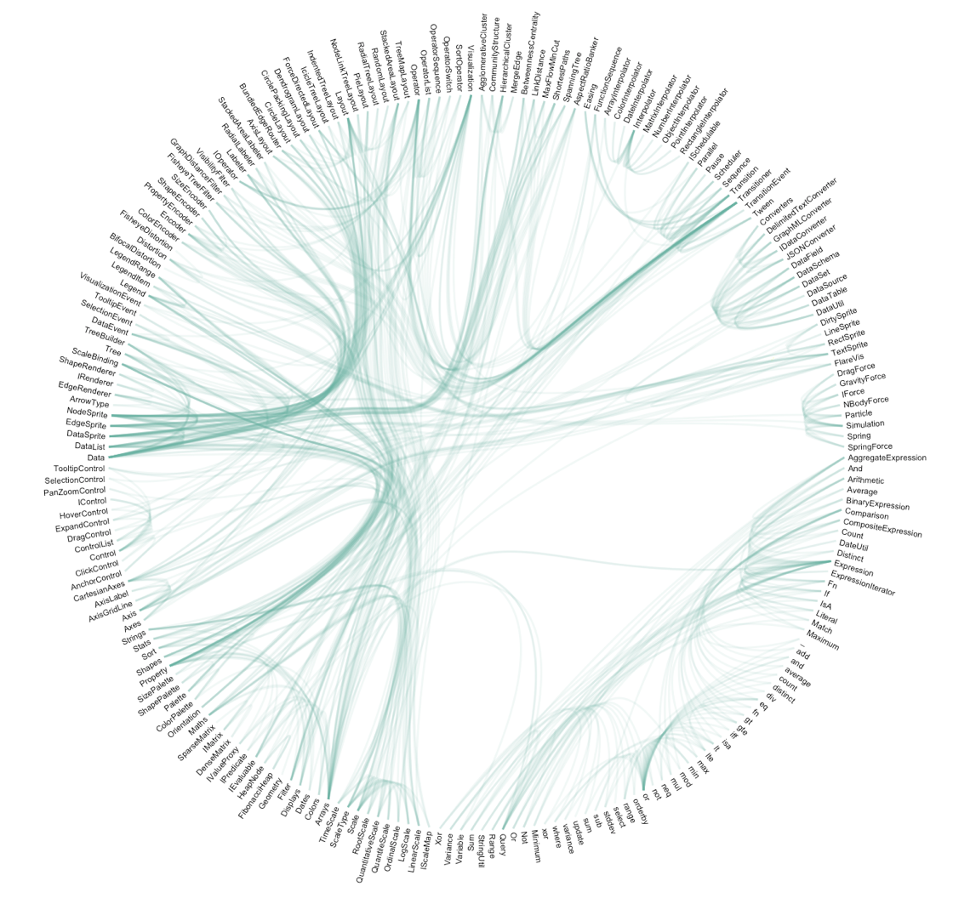
Question – Explo/Expla – Reader – Data – Interactivity – Eye catching
Notes:
Demo story part of the website Show that code is available

Slide 37
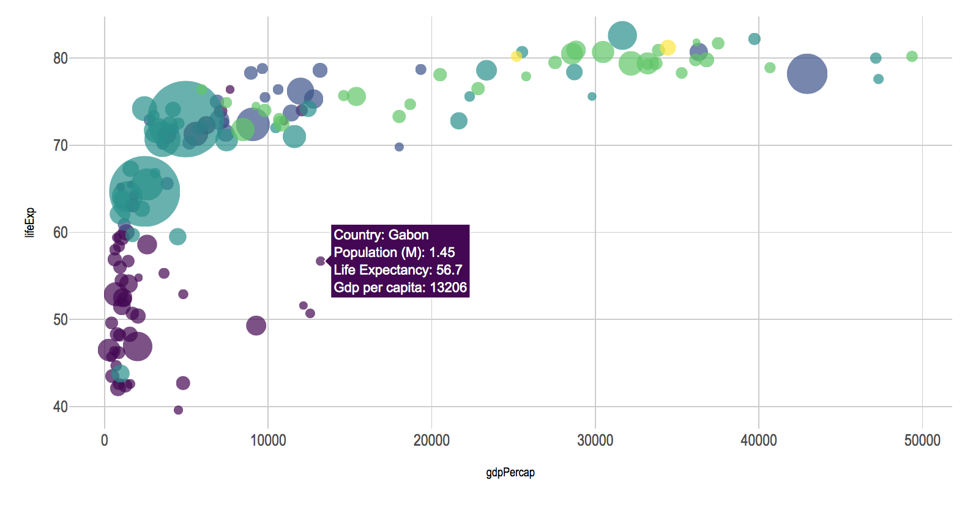
Question – Explo/Expla – Reader – Data – Interactivity – Eye catching
Notes:
Demo story part of the website Show that code is available

Slide 38
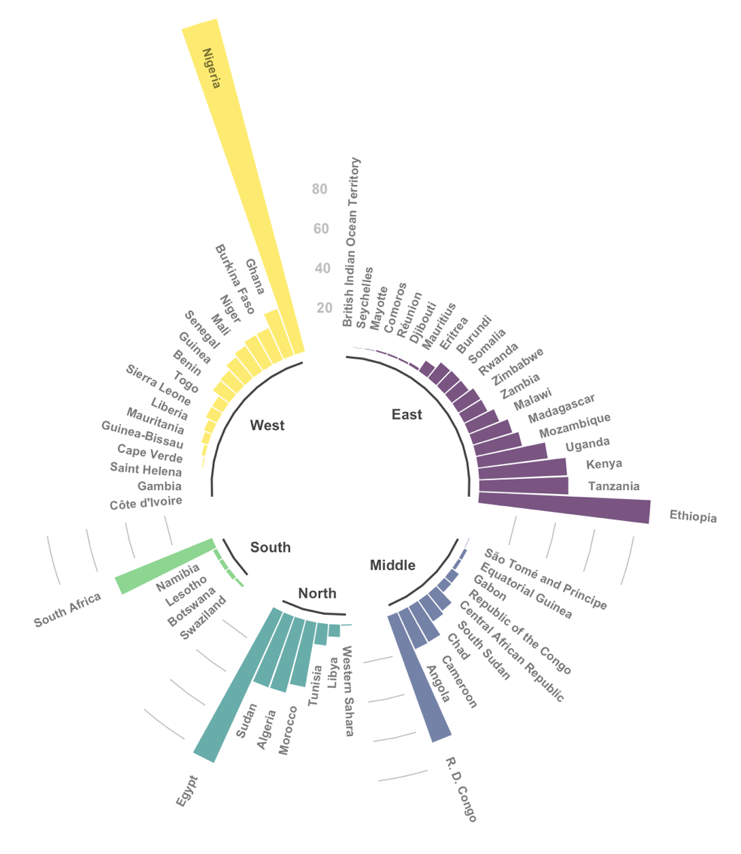
Question – Explo/Expla – Reader – Data – Interactivity – Eye catching
Notes:
Demo story part of the website Show that code is available

Slide 39
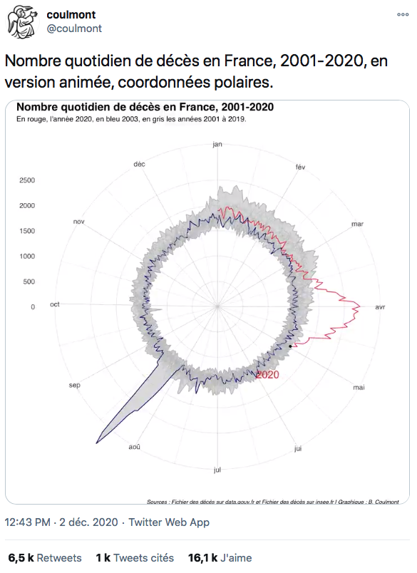
Link

Slide 40
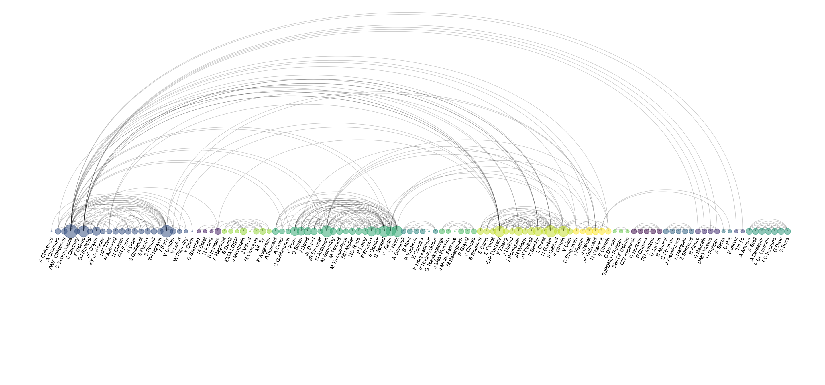
Co-authorship network of a researcher

Slide 41
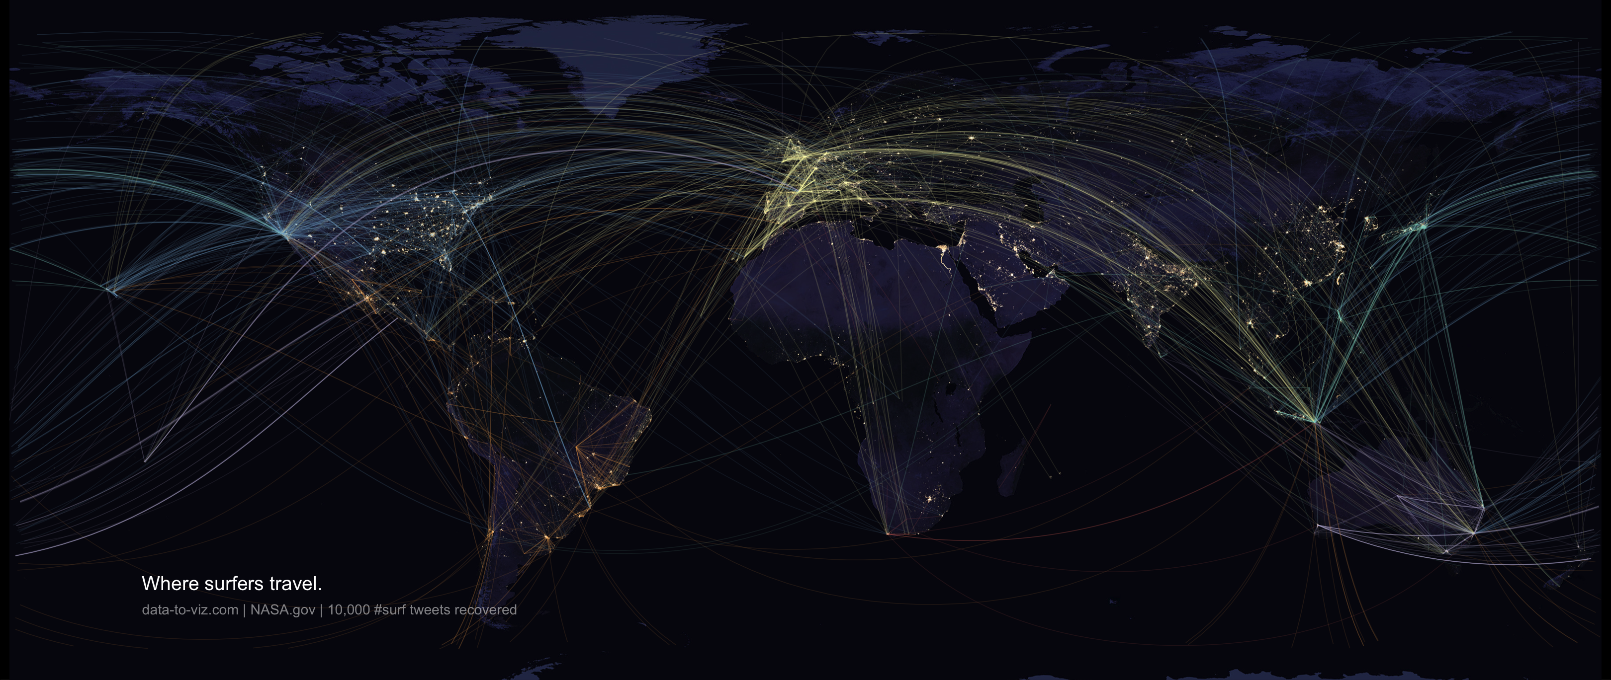

Slide 42
WHAT YOU SHOULD NOT DO
A gallery of most common caveats
www.data-to-viz.com/caveats

Slide 43
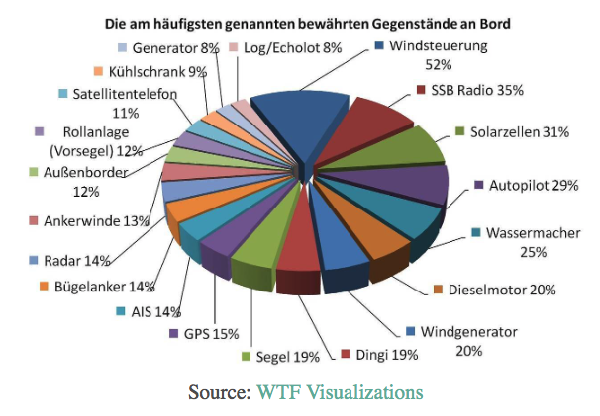
What’s wrong with this chart?

Slide 44
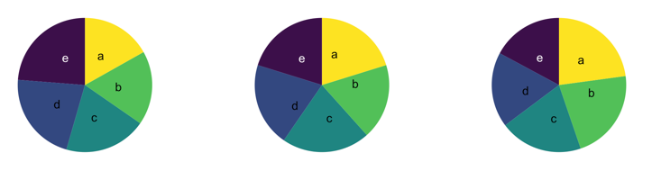
What’s wrong with pie chart?
What can you see?

Slide 45
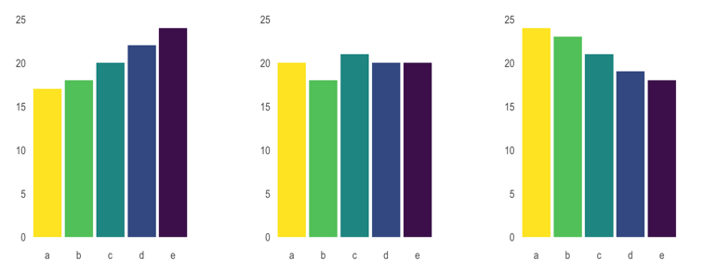
What’s wrong with pie chart?
It is hard to distinguish angles

Slide 46
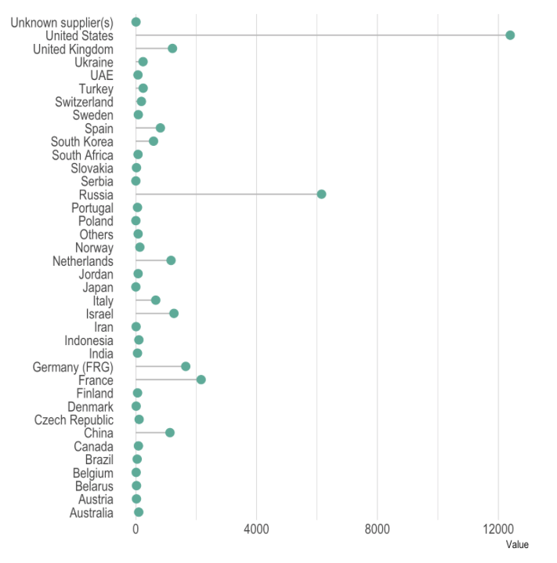
What could be better here?

Slide 47
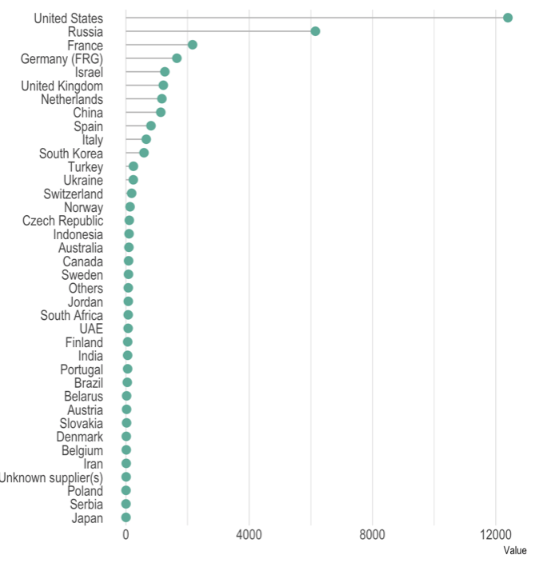
Order your data

Slide 48
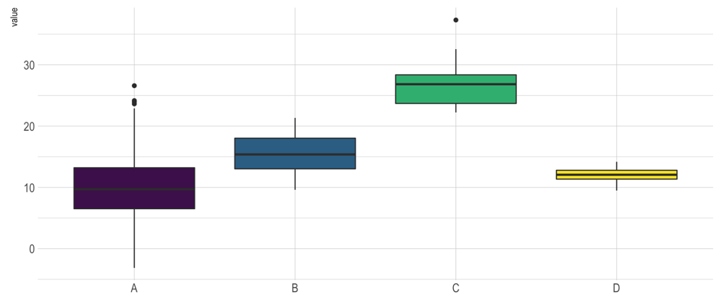
Anything wrong here?

Slide 49
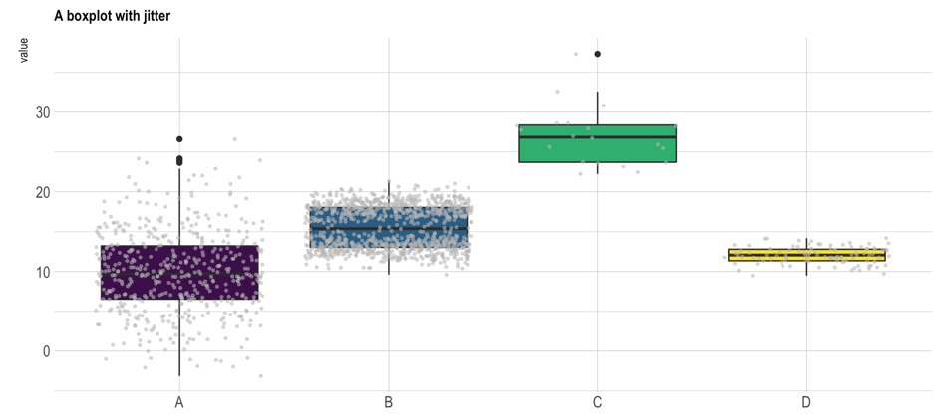
Boxplot = hide information
Almost no data !
Bimodal distribution

Slide 50
Boxplot = hide information
If small sample size, add data points with jitter
Almost no data !
Bimodal distribution

Slide 51
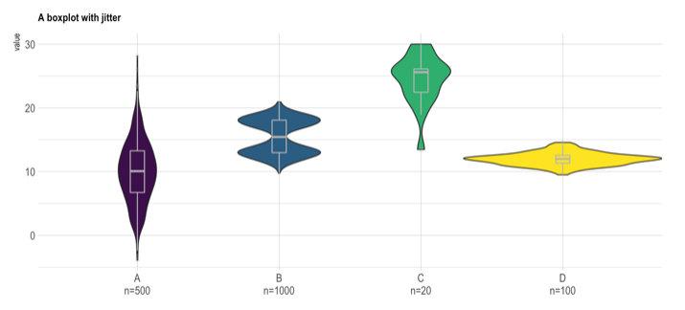
If big sample size, use violin plot
Show distribution
Show sample size

Slide 52
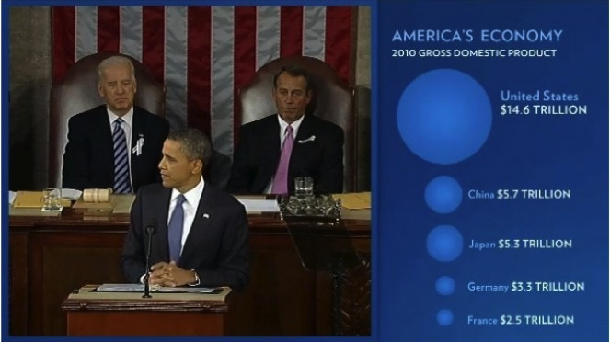

Slide 53
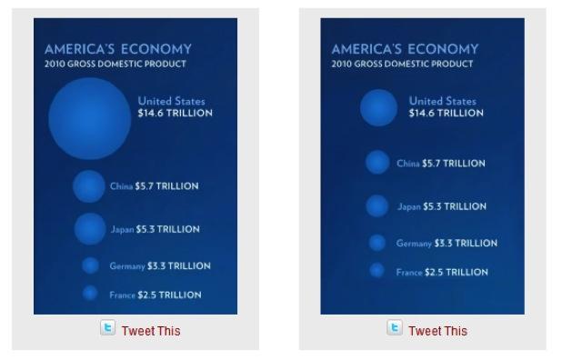
Size = radius
Size = area
Source: Fast Fedora blog

Slide 54
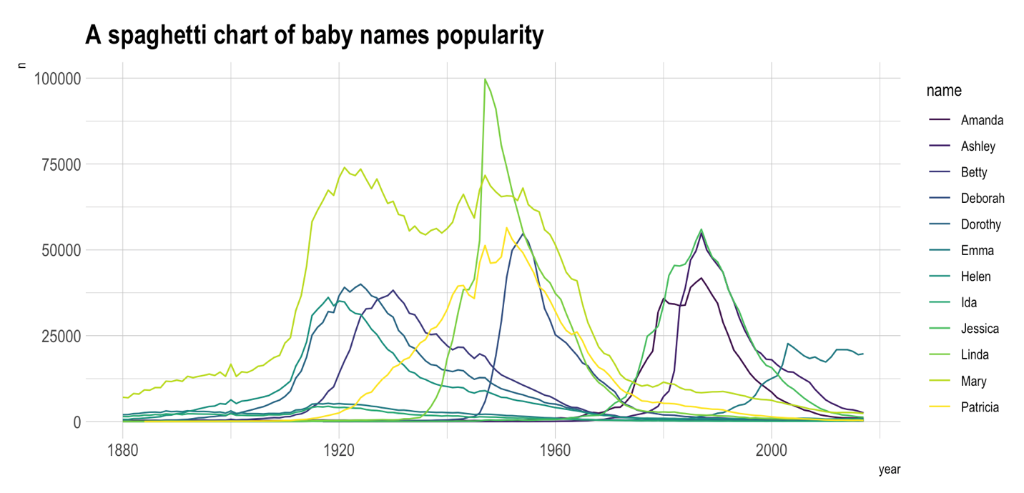

Slide 56
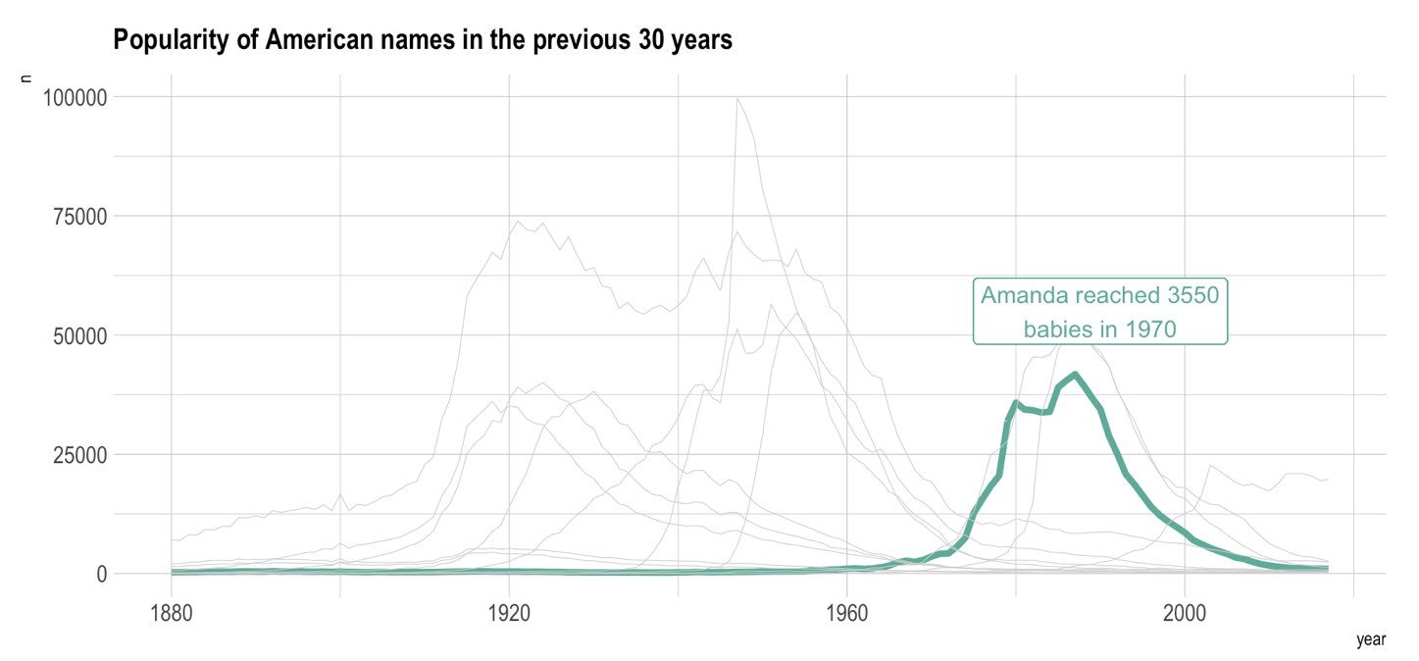

Slide 57
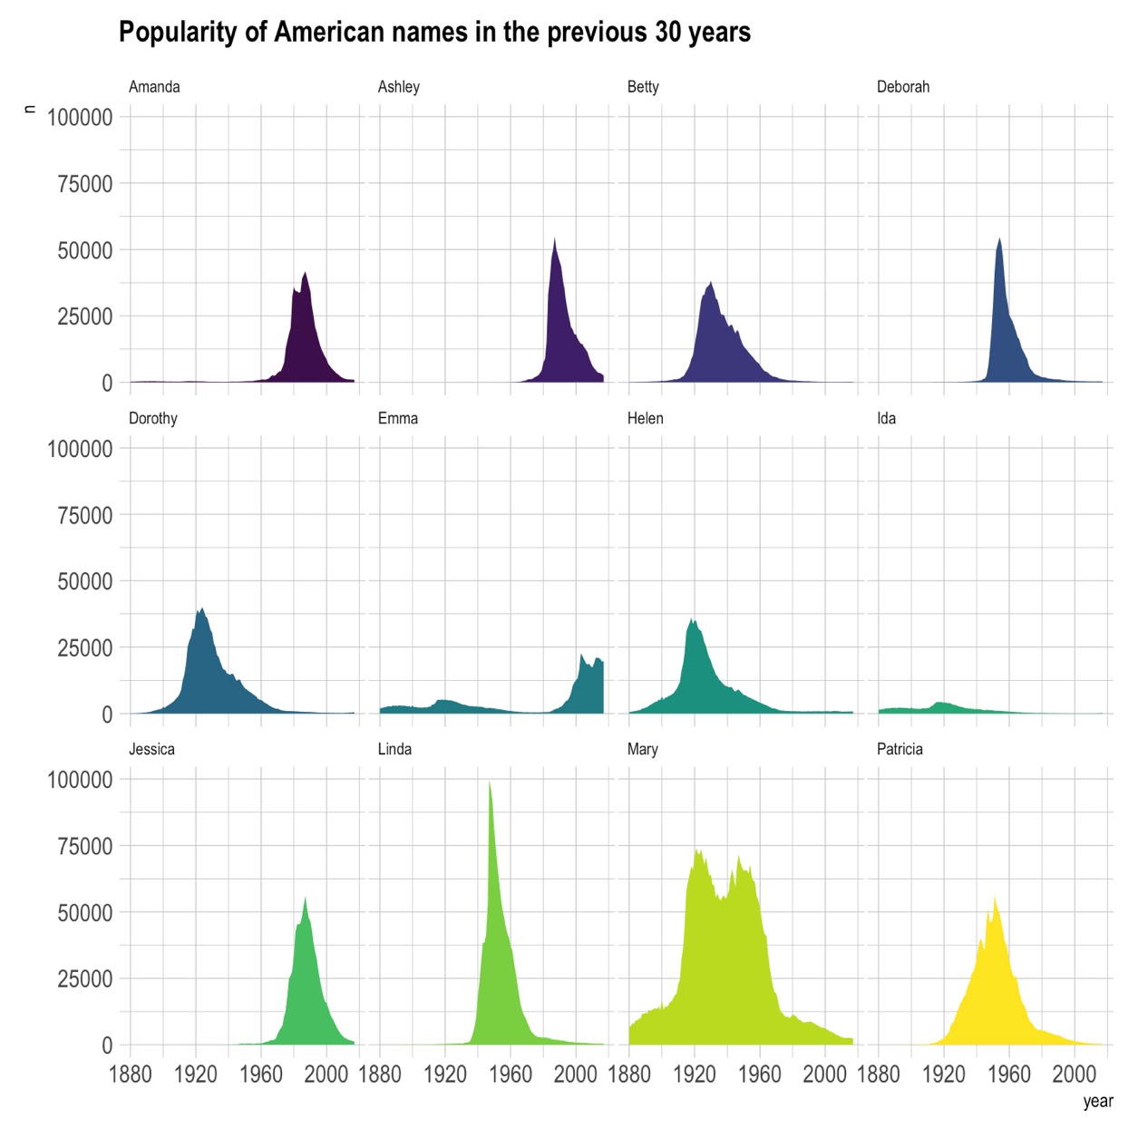

Slide 58
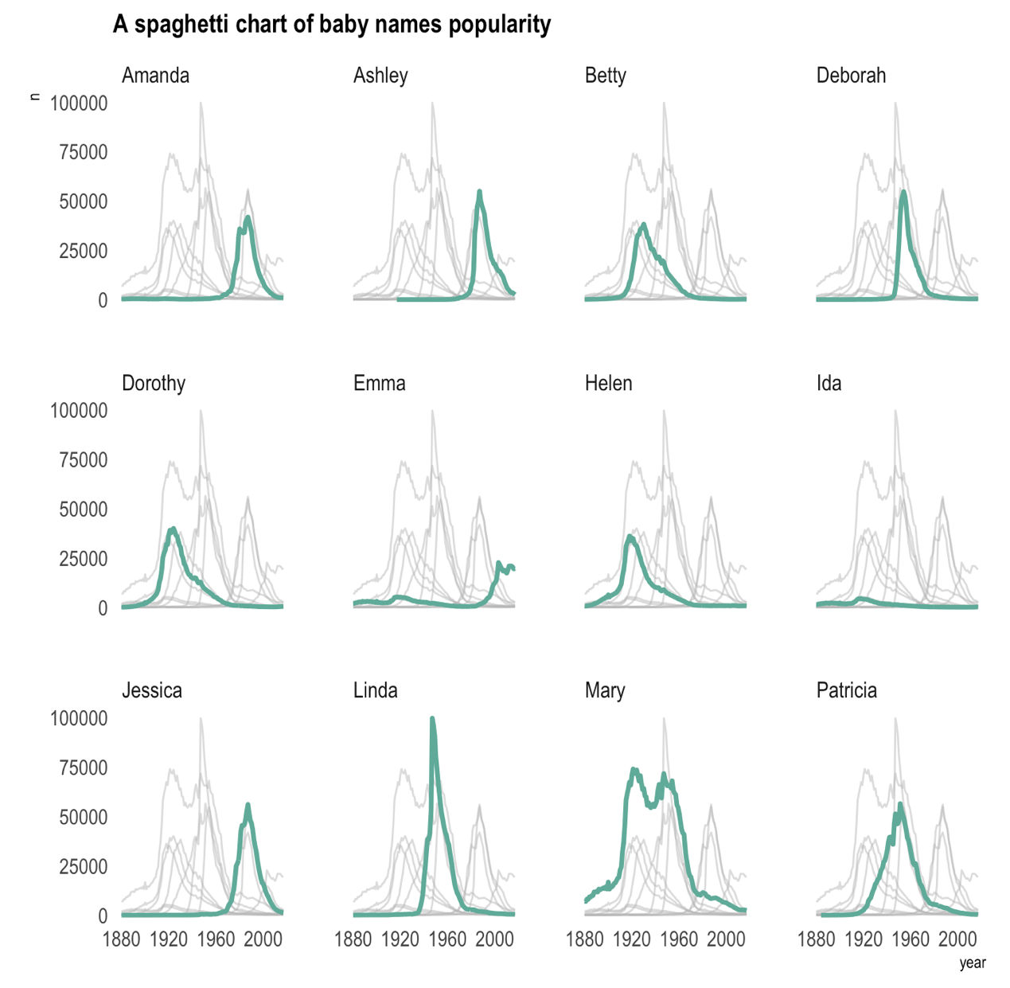

Slide 59
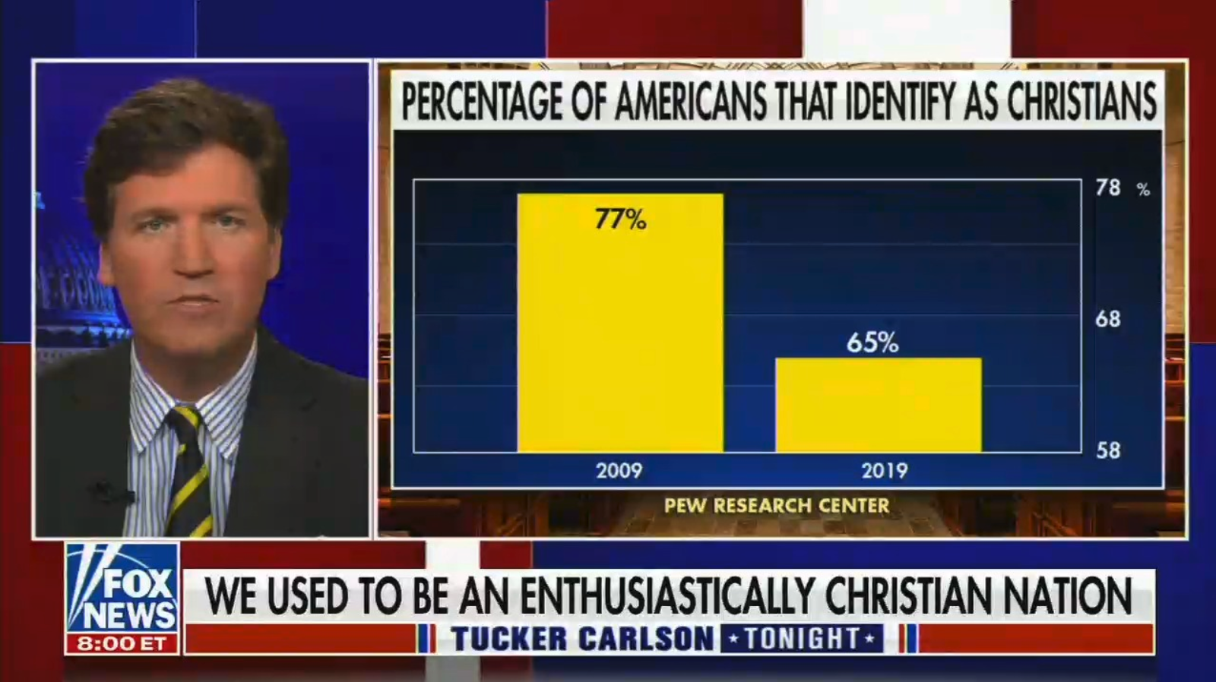

Slide 60
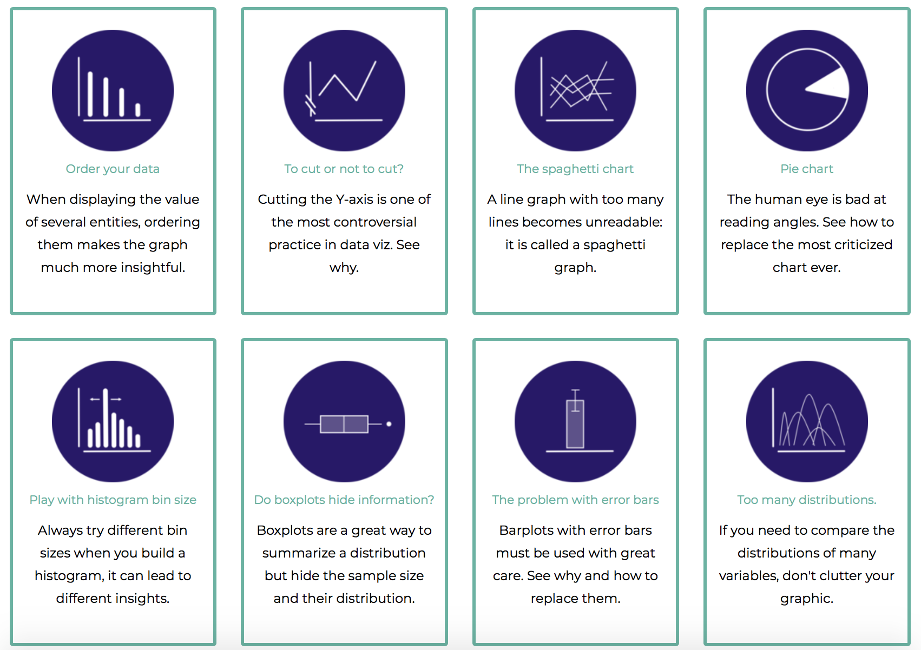
Data-to-viz.com/caveats
Data to Viz
A collection of dataviz caveats

Slide 61
HOW TO DO IT
The R and Python graph galleries

Slide 62
Design the idea
Build it
time
20 %
80 %

Slide 63

Easy
Limited
Hard
Flexible

Slide 64
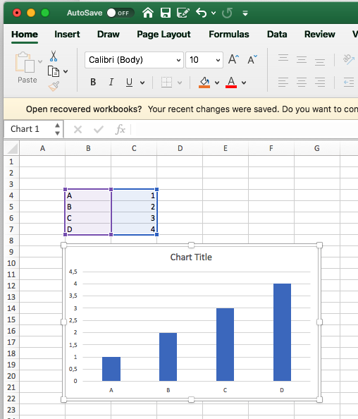
Excel
Easy
Limited
Hard
Flexible

Slide 65
Data Wrapper demo
Data Wrapper
Flourish
Tableau
Jump
Excel
QlikView
Easy
Limited
Hard
Flexible

Slide 66
R graph gallery demo
Data Wrapper
R
Flourish
Python
Tableau
SAS
Jump
MatLab
Excel
QlikView
Julia
Easy
Limited
Hard
Flexible

Slide 67
Data Wrapper
R
Flourish
Python
Tableau
SAS
Jump
MatLab
Javascript,d3.js and the web
Excel
QlikView
Julia
Easy
Limited
Hard
Flexible

Slide 68



Slide 69

R-graph-gallery.com
Python-graph-gallery.com
D3-graph-gallery.com
Notes:
Demo d3-graph gallery.com

Slide 70





Data-to-viz.com
@R_Graph_Gallery
github.com/holtzy/Talk
Yan.holtz.data@gmail.com
www.yan-holtz.com

